Slide 1
Automaton Theories of Human Sentence Comprehension - Ch. 5: Cognitive Architecture for Linguists
2020. 02. 14
Won Ik Cho
Notes:
.

Slide 2
Cognitive Architecture
Cognitive architecture
Term that refers to a collection of basic elements, or primitives, out of which theories of intelligent behavior might be fashioned
What is the cognitive architecture for the thinking human?
What is a good architecture? – Generalizability?
Architecture that allows theorists to re-use the same primitives across domains
Models the way humans do multiple tasks that call upon different aspects of their intelligence
Re-use of primitive elements across tasks and domains >> They correspond to something fundamental about the mind
e.g., Newell (1972)
Goal: defining a process theory
“Posits a set of processes or mechanisms that produce the behavior of the thinking human” ↔ Chomsky?

Slide 3
Cognitive Architecture
Newell (1972) - Human problem solving
(by Cohen, 1981): Newell used methods alien to cognitive psychology to explore questions alien to AI
Not well-known among linguists
But offers an elegant way to reconcile generative grammar with the rest of cognitive science
Production system:
Scheme for specifying an information processing system
Consists of a set of productions
Each production consists of a condition and an action
Also has a collection of data structures - Expressions that encode the info upon which the production system works
On which the actions operate
On which the conditions can be determined to be true or false
A program that computes outputs from some given inputs
In a way that affords a particularly direct psychological interpretation of the intermediate states

Slide 4
Cognitive Architecture
Newell (1972) - Human problem solving
Example of production rules: IF-THEN
IF you encounter the word “the” THEN as an action postulate a noun phrase
IF the goal is to add the first block and the heap of blocks is not empty THEN pick up the nearest block from the heap
IF-THEN highlight the condition and action part
Condition: either T/F in a given situation
Action: specifies a list of things to do when condition == True
Result: Modifying he current data structures
Which leads in the next instance to another (possibly the same) production
When process halts
When no condition is true (nothing is evoked)
When an action containing a stop operation occurs

Slide 5
Cognitive Architecture
Newell (1972) - Human problem solving
Commonality: Absence of externally-imposed control
In case of multiple matches? – Conflict resolution policy: The rule
with most specific consequences
that has not fired recently
estimated to be most ‘useful’ according to some metric
Which ‘Soar’ deals with:
One conceives of parsing as a skill, as procedural knowledge encoded in production rules,
Then a natural way to model syntactic processing is to assimilate ambiguity resolution to the underlying production system’s policy for conflict resolution

Slide 6
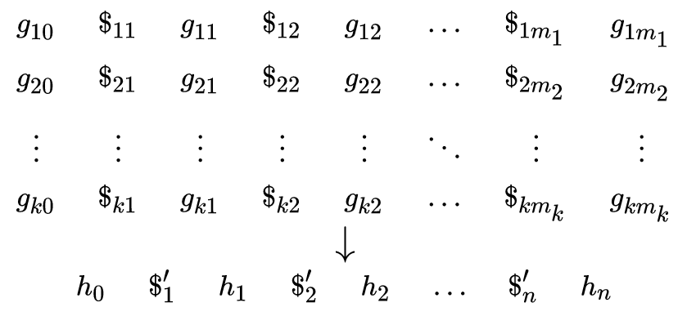
Cognitive Architecture
Newell (1972) - Human problem solving
Different from past AI/cognitive modeling such as Canonical Systems (1943)
A Post canonical system is a triplet (A,I,R), where
A is a finite alphabet, and finite (possibly empty) strings on A are called words
I is a finite set of initial words
R is a finite set of string-transforming rules (called production rules), each rule being of the following form:
where each g and h is a specified fixed word, and each $ and $' is a variable standing for an arbitrary word.
Which is conceptual origin of formalized transformational grammars
as in Chomsky (1957/1975)
https://en.wikipedia.org/wiki/Post_canonical_system

Slide 7
Human performance, NL Soar
Post: Saw himself as exploring the foundations for mathematics
Chomsky: Saw himself as doing the same for the foundations of linguistics
For Newell and Simon,
Production rules took on a psychological interpretation in models of human performance
What is human performance?
For psychologists, refers to ‘the speed and accuracy with which people do things’
Boosted up with the military applications
Trials such as Memory and ACT-R (by Anderson)
What is Soar?
Cognitive architecture that Newell advanced (1990)
Can reason about its own conflict resolution
The conflict-resolution policy for Soar is to apply Soar itself to the problem of deciding what to do
Reifies the each step of problem-solving in an abstraction called an operator, rather than via production rules

Slide 8
Human performance, NL Soar
Individual production rules
Related to operator proposal, selection, and application
What if no clear winner between competing operators?
Tie impasse
Motivates creation of a substate
Substate will be destroyed if enough information given to solve the impasse
Solving this is the key feature of Soar:
Solves its own conflicts using whatever knowledge that is available?
The most important for linguists – NL Soar
Ambiguity resolution in language processing is simply the resolution of impasse by Soar
It does not mean an alternative proposal about grammar
Rather, NL Soar shows how assumptions about grammar and processing could fit together
Built on a premise that a single decision takes 100ms

Slide 9
Human performance, NL Soar
Applications
Lewis (1993)
A theory of garden pathing using NL-Soar in combination with several suxiliary hypothesis
Single-path parsing
Limit on the number of attachment sites
Multiple levels of representation all the way from lexical referential
Parsing automata - Generalized Left-Corner Parsing
Basic idea: To maintain the pushdown stack in working memory
Will be encoded by several cooperating working memory elements
Use the sequence of symbols on top of the stack to condition the operators
IF the top of the stack reads [V, VP, Adv] THEN projecting VP → V VP Adv is an acceptable operator
IF projecting VP → V VP Adv was selected THEN apply it bottom-up by replacing all those symbols with VP
Also used in Attachment, Shift etc.

Slide 10
Thank you!
EndOfPresentation

